Slide 1
Local Control Accountability Plan Committee Meeting
March 12, 2018
Notes:
Good evening!

Slide 2
Agenda
Welcome and Introductions
Past business: Parent Workshops – How is the district supporting parents?
Update on progress: District LCAP metrics
Data analysis – How is the district serving its English learner, Low Income, and Foster Youth?
Update on Stakeholder Feedback and Outreach – How is the district promoting the LCAP and collecting feedback from parents, staff, and students?

Slide 4
Parent Workshops

Slide 5
Update on Progress: District LCAP Metrics
Review the District LCAP metrics spreadsheet
Where has the district made progress?
Which metrics are still “under construction”?
Notes:
Please review the data using the following guiding questions to frame your thinking:
Where has the district made progress?
Which metrics are still “under construction”?

Slide 6
Data analysis
How is the district serving its English Learner, Low Income, and Foster Youth?
There is a significant achievement gap between all students and English Learners.
All groups are underperforming.
Notes:
Data descriptions pop in with a click

Slide 7
Unduplicated Students = English Learners, Low Income, and Foster Youth

Slide 9
Programs and Services to Support English Learners, Low Income, and Foster Youth
Identified in LCAP 2017-20
English Learner Specialists and Coordinators
Program Manager and Services for Homeless and Foster Youth
PUENTE (curriculum and counseling support)
AVID (curriculum)
Parent Empowerment
Site funds for Interventions

Slide 10
LCAP Guidelines
Districts are required to increase or improve services provided to unduplicated students as compared to services provided for all students
Can be targeted to a specific group, school-wide, or district-wide
Increase or Improve = an action or service does increase or improve services for unduplicated students as compared with the actions or services available to all students if, based on local context and need, it is principally directed to and effective in meeting one or more LCAP goals for unduplicated students

Slide 11
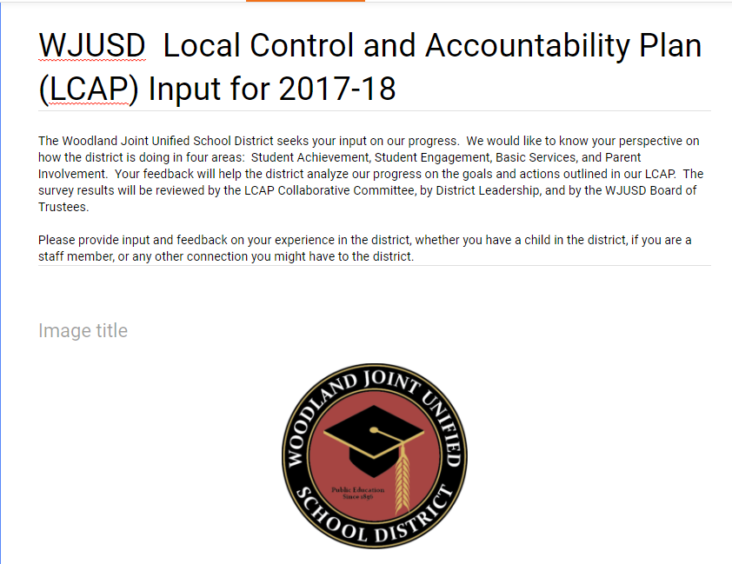
Update on Stakeholder Feedback and Outreach
How is the district promoting the LCAP and collecting feedback from parents, staff, and students?

Slide 12
Questions and Comments

